Slide 1
Baby’s Drawing App

Slide 2
Executive Summary
The Baby's Drawing application is a highly engaging and interactive tool designed specifically for children who love to draw. This application offers a range of features that make the drawing experience both easy and fun. It features a responsive brush for drawing on the screen, various color options, an eraser button, undo and redo buttons, and the ability to save and restore previous drawings. The user interface is designed to be user-friendly, with all buttons and options clearly labeled and accessible. The Contact Us button provides a way for the user to communicate with the development team for any questions or feedback. To add to the interactive experience, the application features sound effects that are triggered when drawing, erasing, changing colors, undoing, and redoing.

Slide 3
Introduction
The Baby's Drawing application is a fun and interactive tool for children who love to draw. It has been designed with the user in mind, with the user interface being easy to understand and the buttons and options being clearly labeled and accessible. The focus on user-friendliness and accessibility makes the application a safe and enjoyable experience for children.

Slide 4
Design and Development
The Baby's Drawing application was developed using Android Studio, which is a widely used development platform for mobile applications. The design of the application has been thoughtfully created to make the drawing experience as easy and fun as possible for children. The brush for drawing on the screen is responsive and provides a smooth and accurate drawing experience. The color options, in the form of a hair game, offer a variety of colors to choose from, allowing the user to add a personal touch to their drawings. The eraser button makes it easy to clean the drawing board, while the undo and redo buttons allow for corrections to be made. The ability to save and restore previous drawings provides the user with the flexibility to continue their creative process even after closing the application.

Slide 5
Functionality
The Baby's Drawing application is packed with functionalities that make the drawing experience enjoyable and interactive. The sound effects, triggered when drawing, erasing, changing colors, undoing, and redoing, add an exciting element to the experience. The drawings created by the user are saved, allowing for continued creativity even after closing the application. This saves the user time and effort as they do not have to start from scratch every time they open the application. The Contact Us button provides a way for the user to communicate with the development team for any questions or feedback, making it easy for the user to get help or provide suggestions for future improvements.

Slide 6
Conclusion
The Baby's Drawing application is a user-friendly and exciting tool for children who love to draw. With a range of features including a brush, color options, an eraser, an undo and redo button, and the ability to save and restore previous drawings, the application provides a creative outlet for children. The user interface is easy to understand, and the sound effects add an interactive element to the experience. The Contact Us button provides the user with the ability to communicate with the development team for any questions or feedback, making it easy for the user to get help or provide suggestions for future improvements. Overall, the Baby's Drawing application is an excellent tool for children who love to be creative, providing a safe and enjoyable drawing experience.

Slide 7
Screen Shots

Slide 8
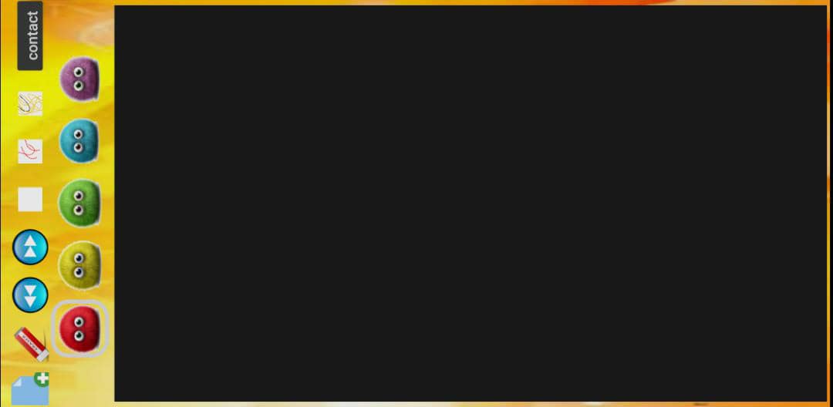
Home

Slide 9
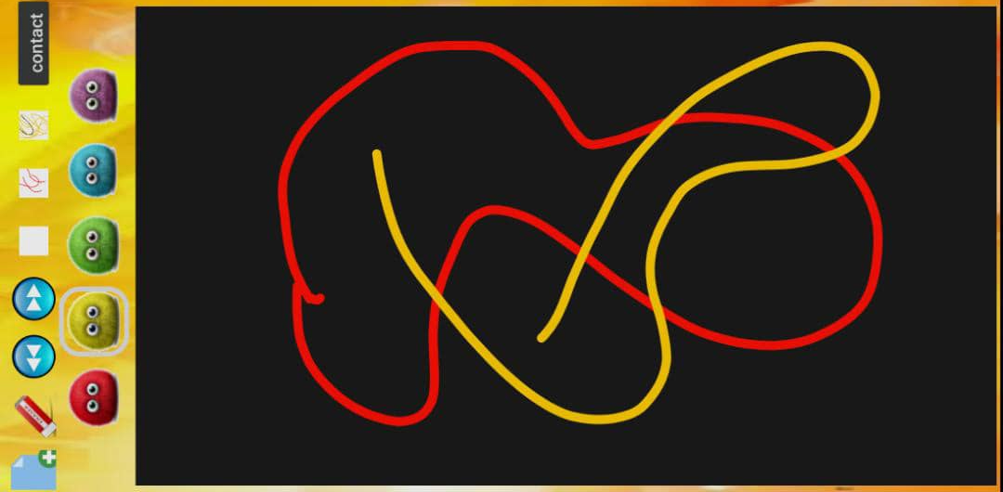
Draw and change Color Screen

Slide 10
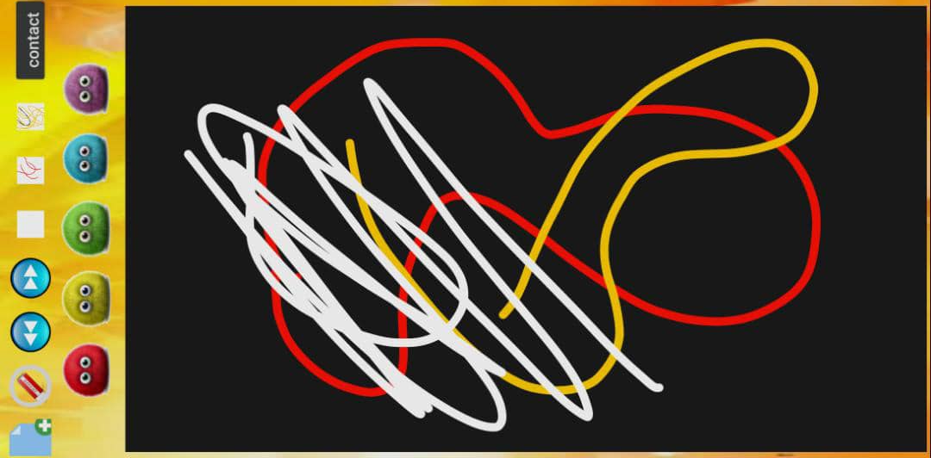
Eraser Screen

Slide 11
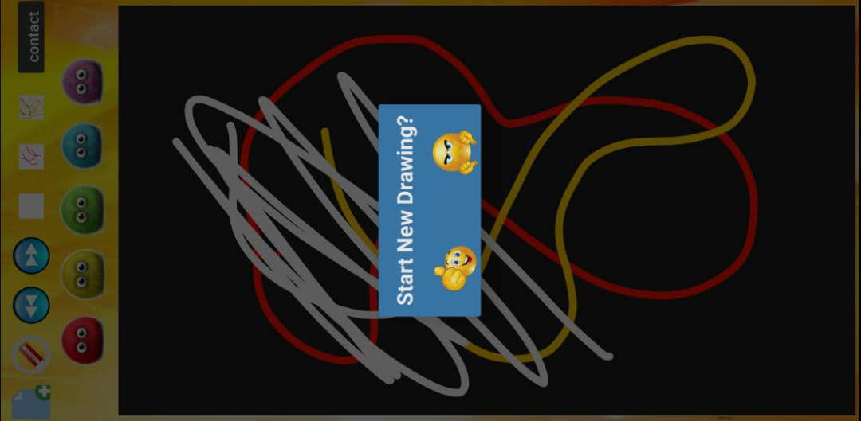
Start New Board Screen

Slide 12
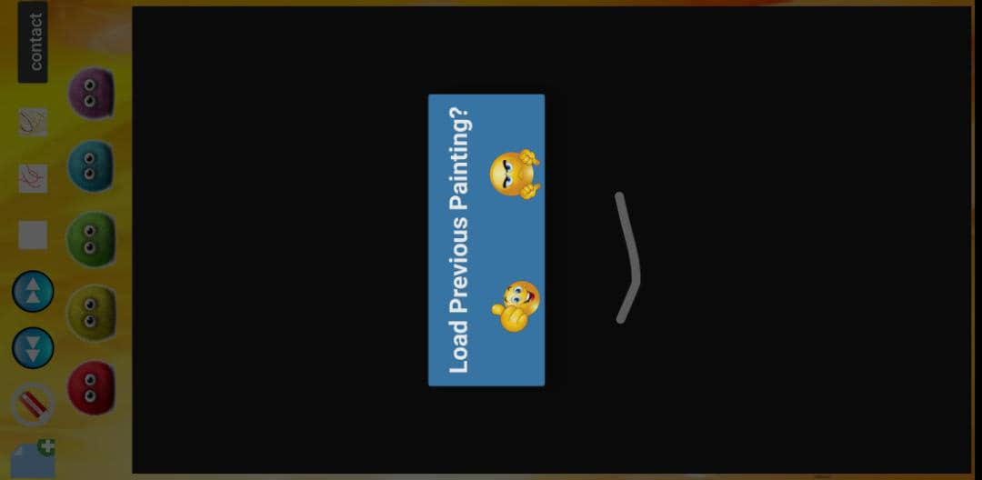
Load Previous Paints Screen

Slide 13
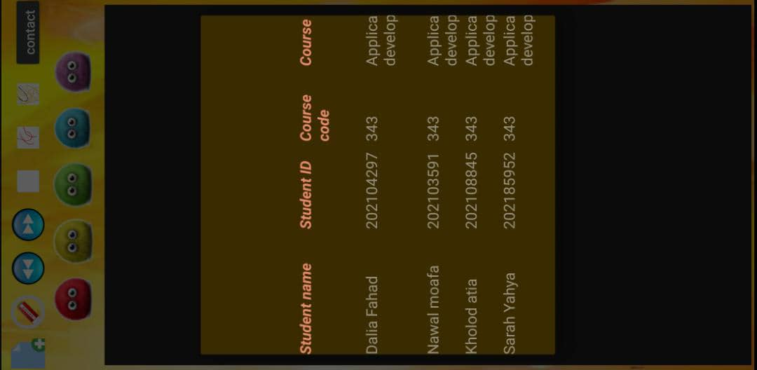
Contact Screen

Slide 14
Thank you

